Slide 1

Green Grocery
An Online Grocery Store

Slide 2
Group No: 30
Group Members :
Neeraj Dusa - S20190010047
Harish Mullagura - S20190010124
Anirudh Jakhotia - S20190010007
Rakesh Ganeshula - S20190010052
Jayanth Sri Ram Kanduri - S20190010084

Slide 3
01
Project Business Cases:
Problem Motivation
The main motivation of the project is to help the farmers to sell their products at a fair price and to provide customers healthy and fresh vegetables, fruits and dairy products at low prices.

Slide 4
Problem Statement
Problem Solution
In these present situations, it is difficult for farmers to sell their products at a fair price in markets. Customers are buying hybrid fruits and vegetables which are not good for health which contains harmful substances. Customers are buying products at high price than market price.
Farmers can sell fruits, vegetables and dairy products at fair market prices on our website and customers can buy directly organic products from farmers through the website which are fresh and healthy for the body.

Slide 5
Project Overall Idea :
Farmers can contact GreenGrocery website and can sell their vegetables, fruits and dairy products at fair prices. The process includes, firstly, the delivery guy pick their products and the management staff are responsible for updating these products on the website. Users can login into the website and can buy organic fruits, vegetables and dairy products which are very fresh and healthy that came directly from farmers. Users can then select their required products and respective quantity of each product and add them to the cart. After adding to the cart, User can checkout and fill in the shipping details and enter payment details. After successful transaction, user will get order confirmation and tracking link. Users can resolve their queries in the Contact Us section.

Slide 6
Unique features of website &
How this website is different from Other Websites?
Unique and friendly UI / UX
There is no website with similar idea or similar UI / UX
Many websites sell the Hybrid products, but we are selling natural organic healthy products.
This website directly contact with farmers and take products directly from them with no intermediate. No other website is currently doing it.
Free of bugs
Give Farmer a gift every month who donates the more quality of vegetables,fruits and dairy products
Rapid and safe COVID preventive measures taken care while delivery
Management team will personally go and make dealership with farmers for wide range of varieties of products
This website will provide funds for farmers by giving some share of profit collected through the website.

Slide 7


Function Description
Modules : 8
Module 1: UI/UX Design
This is the first and important module in developing our website. An interactive UI/UX makes customer satisfied.

Slide 8

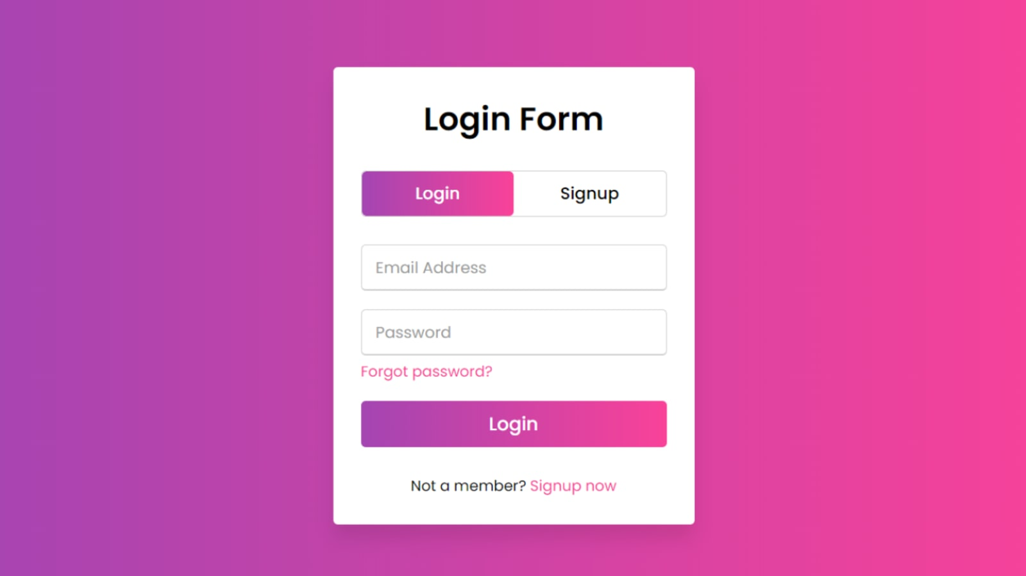
Module 2: Login/SignUp
The existing users of our website can Log In through username and password in this section. Now, If you are a new user around here, you can sign up by providing name, mail-id and username. The user-id and password will be added to database and will be maintained securely through some hash and salt techniques
Module 3: Authentication
We have to use certain API’s for connecting to the application and providing an Interface for Authentication Purpose.

Slide 9

Module 4: Database Management
We used MongoDB for maintaining the back-end of our website. By this, we connected to database and perform CRUD operations and maintain user records and farmer products and contact us queries.

Slide 10
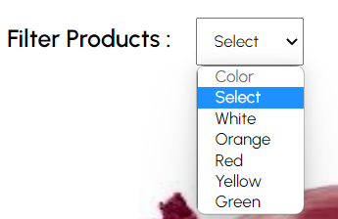
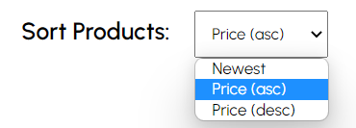
Module 5:
Product Categories and Navigation
In this module, color and prices are displayed using a drop down menu and the user can navigate through the category they want and filter/sort the products.

Slide 11
Module 6: User Needs
On Choosing:
¨Shop Vegetables” will lead to where there will be vegetable products along with filter. The users can now select the desired vegetables and their quantity and add them to the cart
“Shop Fruits” will lead to where there will be Fruit products along with filter. The users now can now select the desired vegetables and their quantity and add them to the cart
“Shop Dairy Products” will lead to where there will be Dairy products along with filter. The users can now select the desired vegetables and their quantity and add them to the cart.

Slide 12
Module 7: Product Page
In this page, one can find all particular category products like vegetables or fruits or dairy products along with filters.
For each vegetable ,there are details of the product in this section with product name, description, price and selection of quantity.
The products can be added to the cart proceeding with a checkout form including shipping address and then the payment of the order can be done.

Slide 13


Module 8:
Deployment and Hosting
We will test our website for 2-3 weeks before deploying it for finding any bugs in the functionality of website.
We currently have hosted our website on GitHub and will deploy it on cloud based services such as Heroku.

Slide 14
Preliminary Work
Before Starting Project
We drew an outline of our website
We searched for places where people require the organic food most
We will tie-up with delivery companies
We will collaborate with other websites
We will initially collect few products and provide them as a catalog to the users

Slide 15
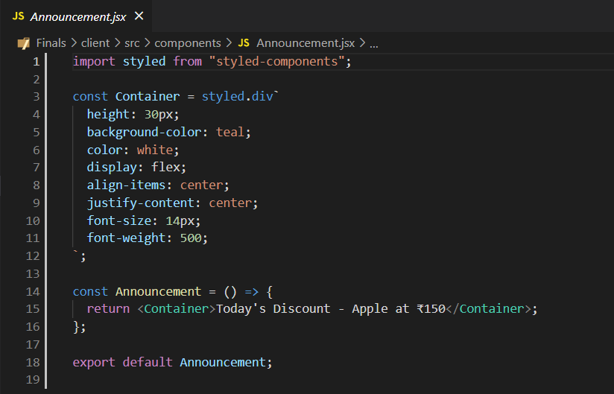
React Components Used
This is an example of Functional Component used. By writing a javascript function, we can create a functional components in React App.
Functional
Components used :
Announcement
Navbar
Slider
Categories
Products
Newsletter
Footer

Slide 16
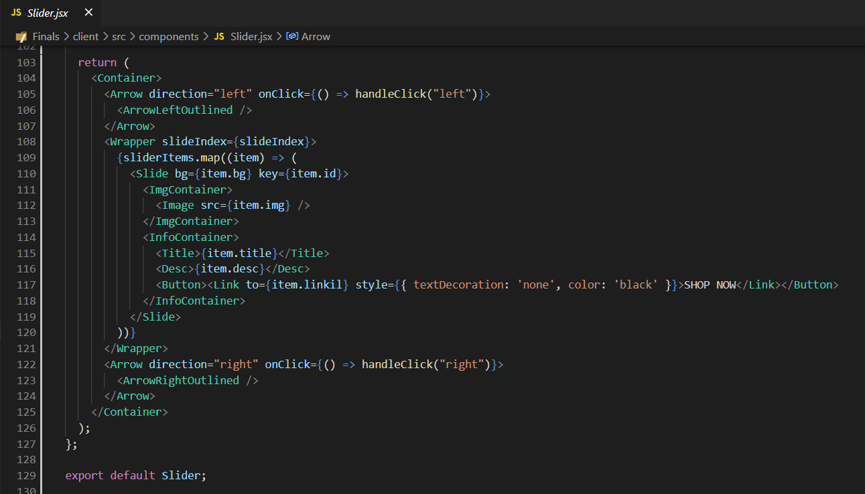
React Higher-Order Components are popular advanced React pattern to deploy reusable logic and functionality across React components.
Here, in the slider component we used the function takes an array, usually from state which was retrieved from backend with fetch or from props passed down from parent component, and maps each element in the array, transforming each element in the array into a React component.

Slide 17

React-UI Elements used:
React Material -UI
React Material-UI is a set of React components that implements Google's Material Design.
Material-UI is a library that allows us to import and use different components to create a user interface in our React application
Material UI comprises lots of configurable and accessible UI widgets and saves a lot of time.

Slide 18
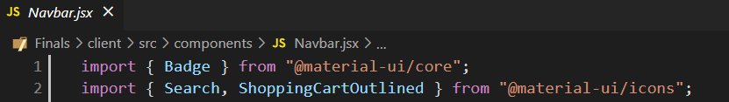
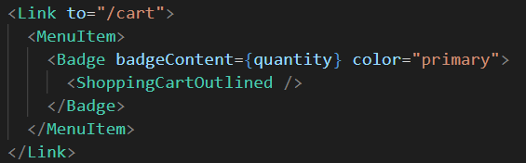
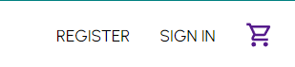
We used Material-ui icons in many components. For example, In Navbar component we used for Search, Badges at the top right corner in Navbar.
Imports :
In code customization :
Rendered on Website :

Slide 19
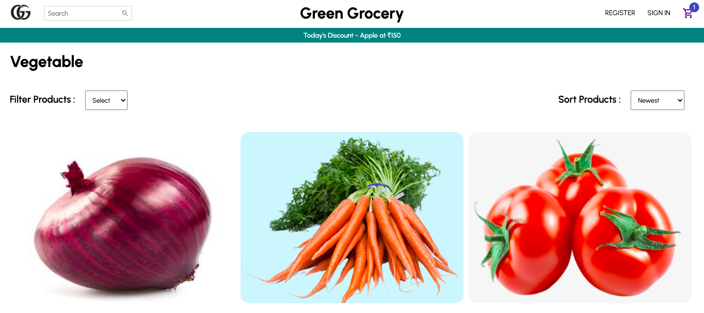
Views - Involves calls to backend to fetch data and display it to the user
Vegetables View Page

Slide 20
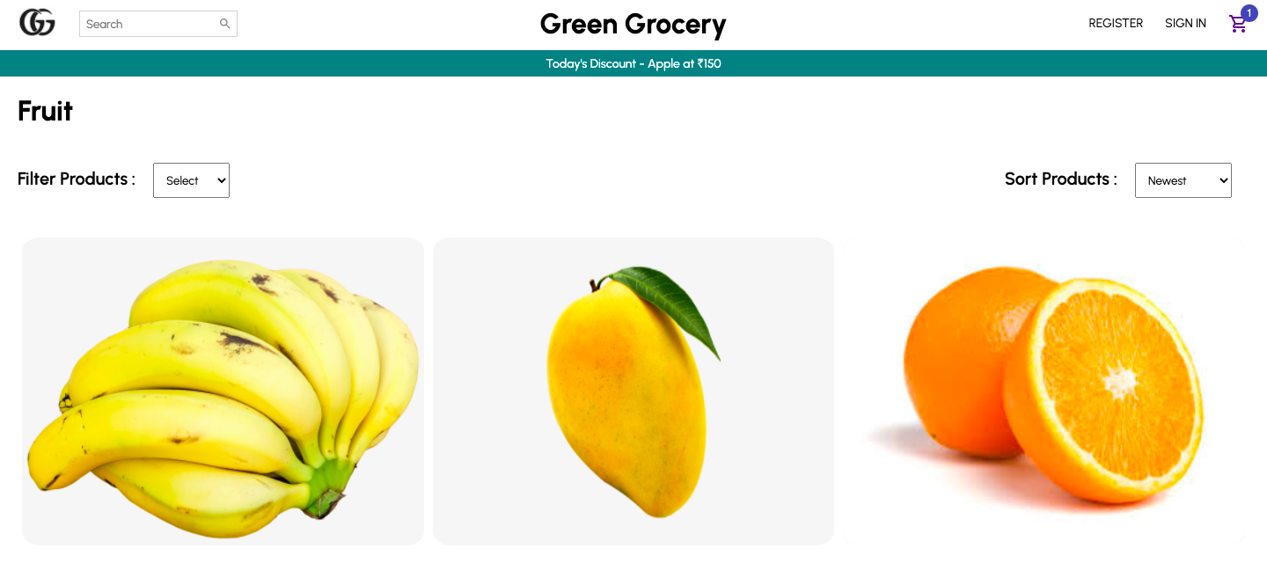
Fruits View Page

Slide 21
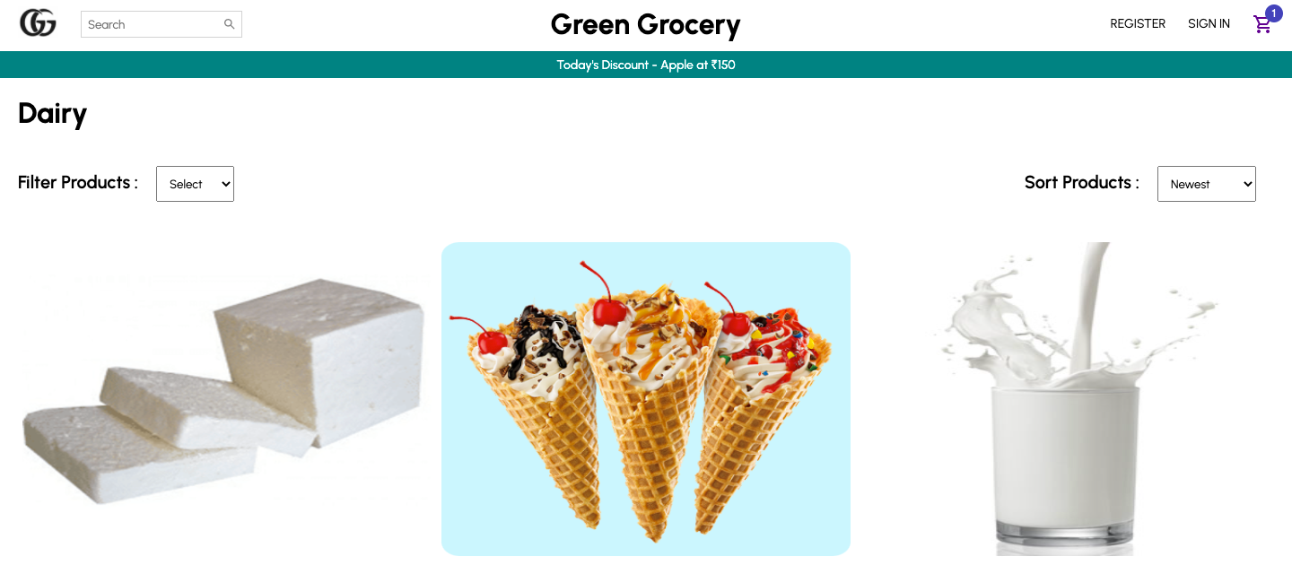
Dairy Product View Page

Slide 22
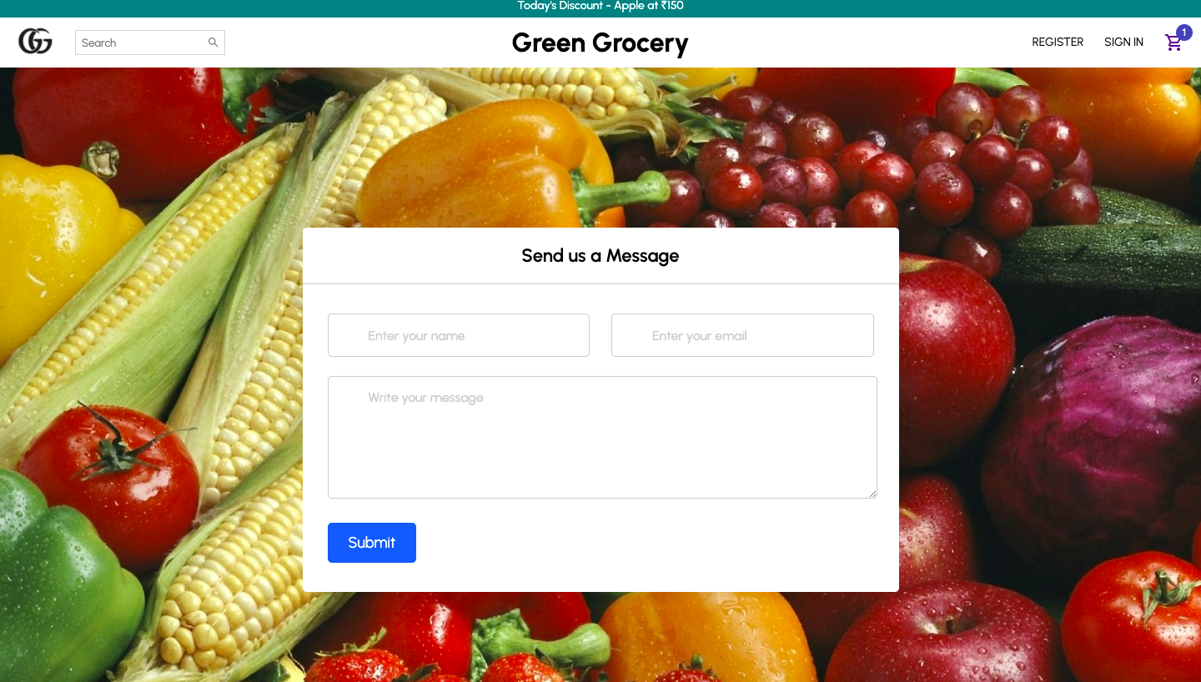
Form -Involves presenting a form to collect user-input, validate, process and post to the backend server
Contact Form Page

Slide 23
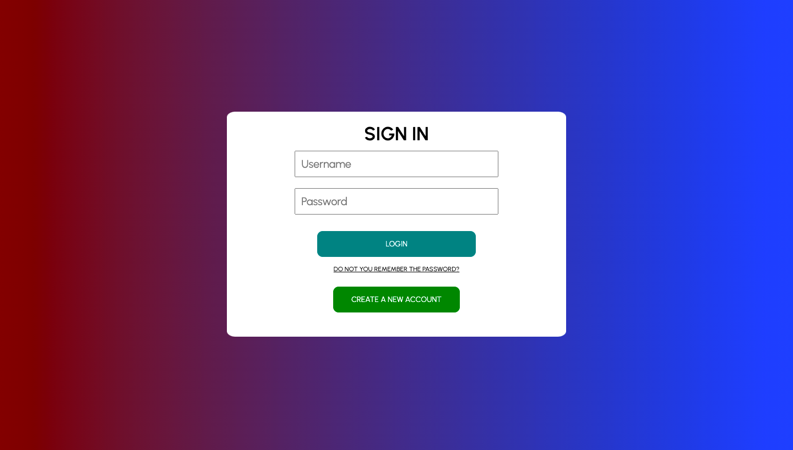
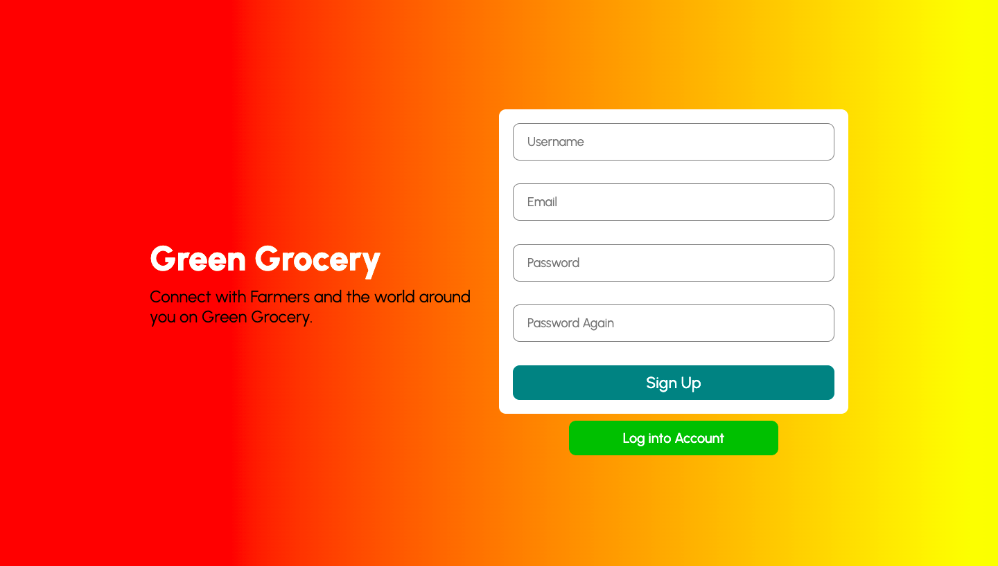
Log In
Sign Up

Slide 24
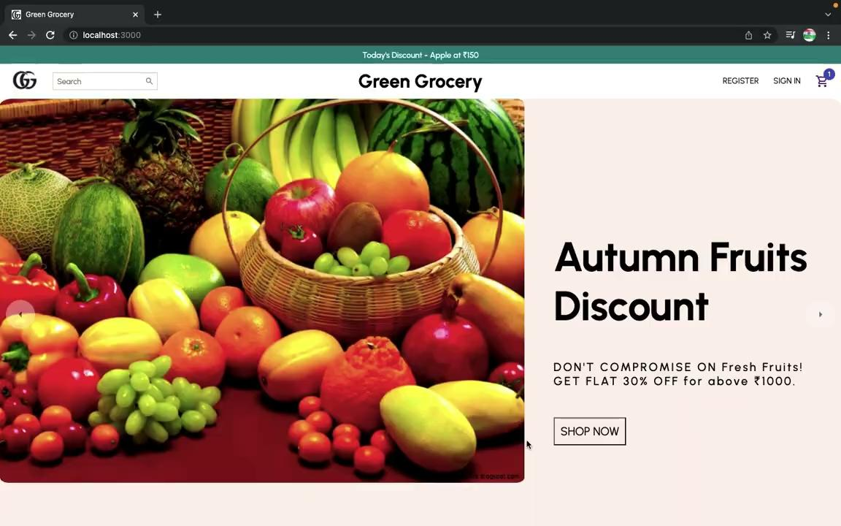

Slide 25
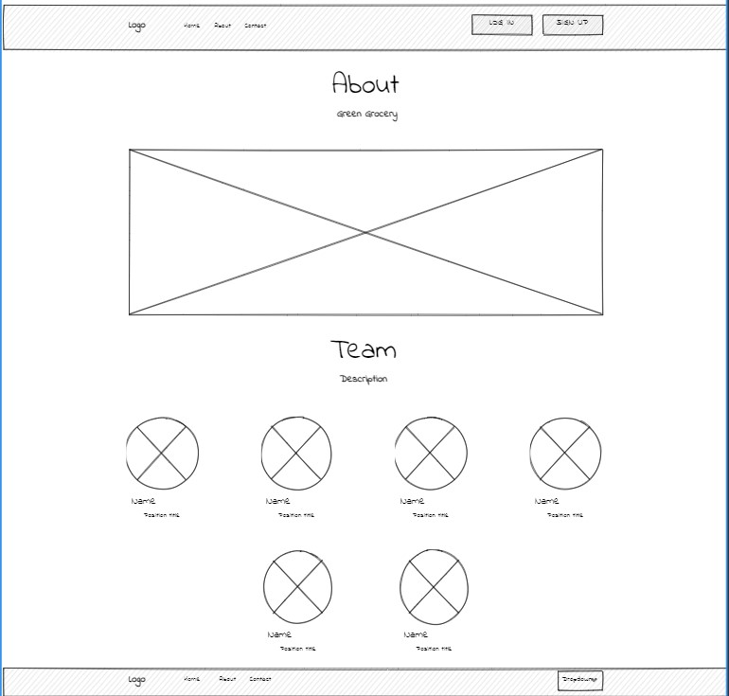
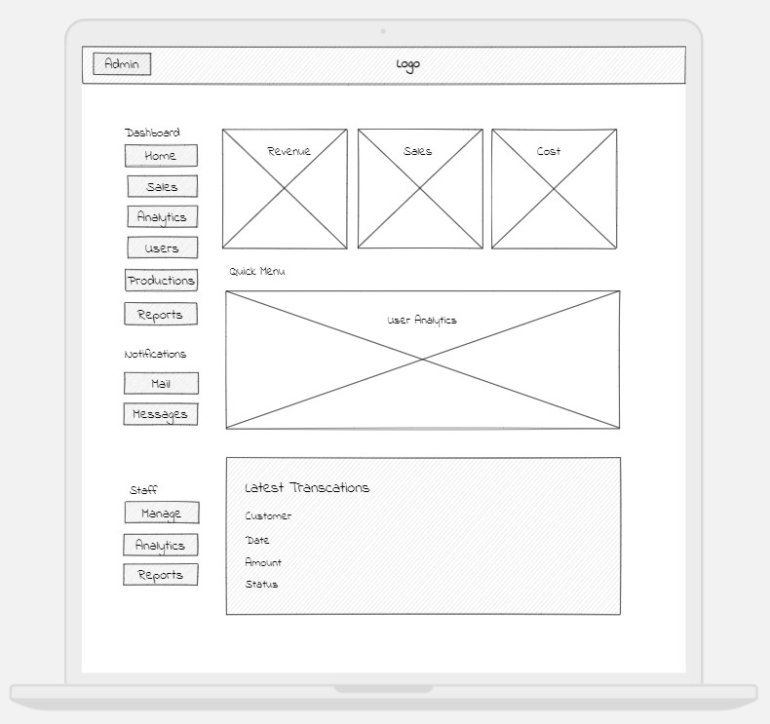
Design of Wireframes
This is the the early step of the future UI/UX design process when the structure of the project is being formed.
It is a two-dimensional illustration of a page's interface that specifically focuses on space allocation and prioritization of content. Wireframes are kept in code folder
We have designed the wireframes of About and Admin Page.

Slide 26
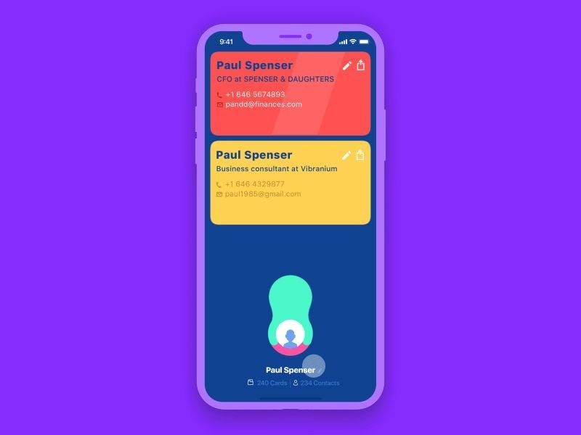

FEATURES
Better UI/UX
Easy Usage

Slide 27

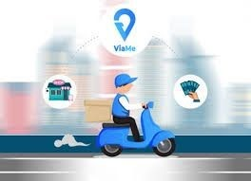
Cash on Delivery
Clean navigational menu

Slide 28


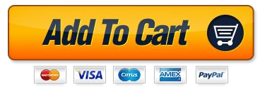
Good quality product photos with image zoom and thumbnails
Wish-list and Add to cart

Slide 29


QNA Queries
For any queries about the books and other details can ask questions and will be replied soon
Discount offers
Many discounts can be given to the farmers based on fresh and quality products they deliver

Slide 30


Suggestions and user feedback is taken
Secure Login and User information is safe

Slide 31

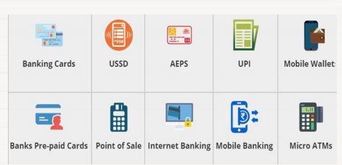
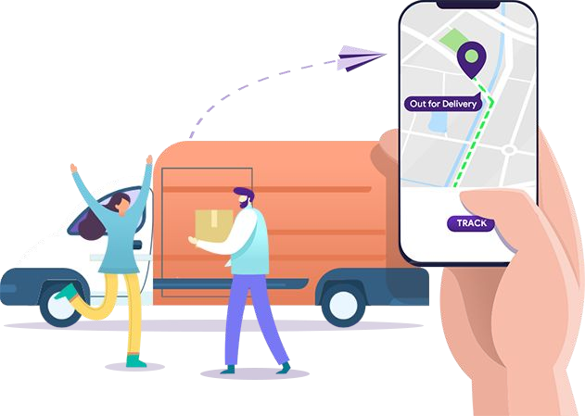
E-Payment
Tracking Option for Orders

Slide 32


Connectivity
Delivery can be reached for various places across India
Sending Email Address
Can send a direct email for others to check about the website and can can interact with farmers

Slide 33


Engaging and informative “About Us” page with contact details.
Social media connections

Slide 34
Task Assigned
Rakesh Ganeshula - Contact us, Contact (Backend), Wireframes
Harish Mullagura - Each product details, Cart, Products (Backend)
Neeraj Dusa - Login, Sign-Up, Payments, Success
Jayanth Sri Ram Kanduri - Each Product Categories, Navbar, Wireframes
Anirudh Jakhotia - Slider, Footer, Users (Backend)
NOTE: Home page was done by everyone equally together

Slide 35

Thanks!
DO YOU HAVE ANY QUESTIONS?
fsdproj30@gmail.com
+91 98765 43210
GreenGrocery.com

